Slide 1
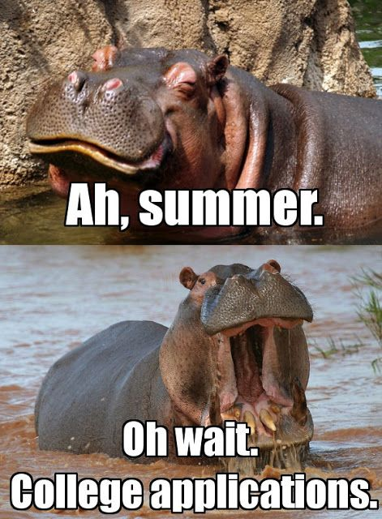
College Summer Planning 2025-26

Slide 2
General Summer To Dos
Submit Community Service and/or Work Hours - Organize, get approval for, and submit all current community service and/or work hours to Mr. Bergman or the Front Office (Mrs. Manders)
Finish HOPE and Other Online Coursework - Sign up for and complete all required online courses and/or HOPE coursework by the end of the summer
If you're an athlete using a HOPE waiver, contact your coach now and have them complete and submit the form as soon as possible

Slide 3
College Summer Planning - SchooLinks Tasks
SchooLinks Tasks - Complete the following required items on SchooLinks. (Feel free to complete any overdue tasks!)
Set/Update your profile (click Settings in the top-right corner; update your email and phone number, and invite at least one parent/guardian)
Upload your Resume (Click folder next to your name → Add File)
Set/Update your College Goal
Complete the College Application Process Learning Unit.
Explore and Favorite Colleges of interest

Slide 4
College Summer Planning - SchooLinks Tasks
Upload Requested Documents to SchooLinks - Upload the following to SchooLInks or send via email to Mr. Bergman:
A Personal Resume - If you have not already created and uploaded a resume, it is strongly recommended that you do so. Many universities allow an educational resume to provide detail beyond the Common App Activities section. Templates available on request
Student Questionnaire and Prompts: Available on the PVSCC website

Slide 5
College Summer Planning - The Common Application
Common Application 2025–26
Create a Common App account now at Commonapp.org
Familiarize yourself with the format and requirements
Note: Beginning this year, your work—including essays—will carry over if you create an account before August 1st

Slide 6
College Summer Planning - Common App Essay
Common App Essay/Personal Statement – By now, your English teachers have introduced the 2025–26 essay topics and shared resources. Summer essay tasks:
Choose your essay topic
Begin writing and develop a strong draft before school starts
Your Senior English teachers will provide feedback on your draft. Be ready to share!
Tip: Check out college-specific supplemental essay questions in the "My Colleges" section of Common App. (Note: These may change in August, so anything entered may be overwritten)

Slide 7
College Summer Planning - Testing
SAT and ACT Testing – Summer 2025 - Take if needed!
ACT (Online only, Science optional)
June 14 – Register by May 9 | Photo upload deadline: May 27
July 12 – Register by June 6 | Photo upload deadline: June 20
SAT/College Board
June 7 – Register by May 22 | Late changes: May 27
August 23 – Register by August 8 | Late changes: August 12

Slide 8
College Summer Planning Letters of Recommendation
Teacher Letters of Recommendation - If your chosen colleges require recommendation letters
Speak in person with the teachers you'd like to ask
Florida public universities do not accept recommendation letters
Do not request letters through Common App. This will be done via SchooLinks after school resumes in August. (Instructions to follow)
A counselor from me is automatic and does not need to be requested. Please make certain I have your resume and prompts responses!

Slide 9
College Summer Planning - Your Final College List
Finalize Your College List - Research and refine your college list:
Know thyself
The goal should be "best fit,” not "best name”
Be careful to not overvalue or undervalue a college
Program, Place, People, Price, Priorities! Research
Best “fit” analysis must take Net Price into account - “Hope is not a plan”
Create a reasonable, diversified, well balanced college list (Reach, Target, Likely). Be careful not to overapply!
Your list is your list. Do not listen to the "noise"
Review/note deadlines and all required materials for colleges on your list!

Slide 10
College Summer Planning - August 2025
What's Coming in August - A letter/email home will include:
Instructions for syncing the Common App with SchooLinks
How to complete the Self-Reported Academic Record (SSAR)
A Transcript Request Form listing the colleges you’re applying to
Detailed instructions for requesting teacher recommendation letters
Class meetings in August and September to guide you through the process and answer any remaining questions

Slide 11
College Summer Planning - Appointments
Appointments with Mr. Bergman - If we haven't met and you or your parents would like to:
Initial appointments will resume in August and will continue through November/December
Mr. Bergman's Fall youcanbookme calendar opens on August 1st - https://lancebergman.youcanbook.me
Follow-up appointments (20 minutes) will also be available
For now, please direct any questions to my email which I will be checking periodically throughout the summer
lance.bergman@sarasotacountyschools.net

Slide 12
College Summer Planning - A Final Note
I know this is a lot—but organizing and planning over the summer will make your Senior year (and the college application process) far less stressful. Take time to rest and recharge, and I look forward to working with you in the fall.
Have a great summer!
Sincerely, Mr. Bergman

