Slide 1
Spring College Night: Pine View College Night: College Planning and the College Admissions Landscape 2025-26
April 2025

Slide 2
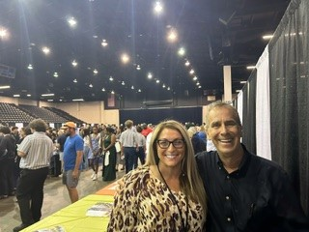
Brought to you
from Pine View's
College Counseling Team
Mr. Bergman & Dr. Wiley

Slide 3
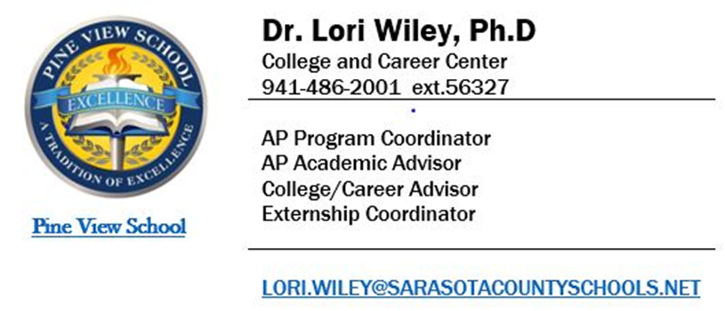
Dr. Lori Wiley
College Advisor, Pine View School

Slide 4
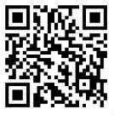
General Housekeeping
Please hold Individual Questions during the presentation
Moderated Q & A at the conclusion of the presentation tonight
Question Code – scan and submit
All questions will be answered, and posted on pvscollegecounseling.com

Slide 5
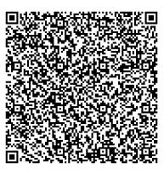
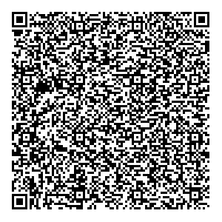
Testing Plan
SAT Registration
ACT Registration
(satsuite.collegeboard.org)
(act.org)

Slide 6
Mr. Lance Bergman
Senior College Advisor, Pine View School

Slide 7
Class of 2026 Winter-Spring College Planning Events
January-February 2025
Senior Scheduling (Classrooms)
February 2025
Intro to College Planning I (Classroom)
March - June 2025
Meetings with Mr. Bergman
April 15th
Junior College Night/Outcomes Presentation
Week of May 26th
Summer College Kick-Off Presentation (Class)

Slide 8
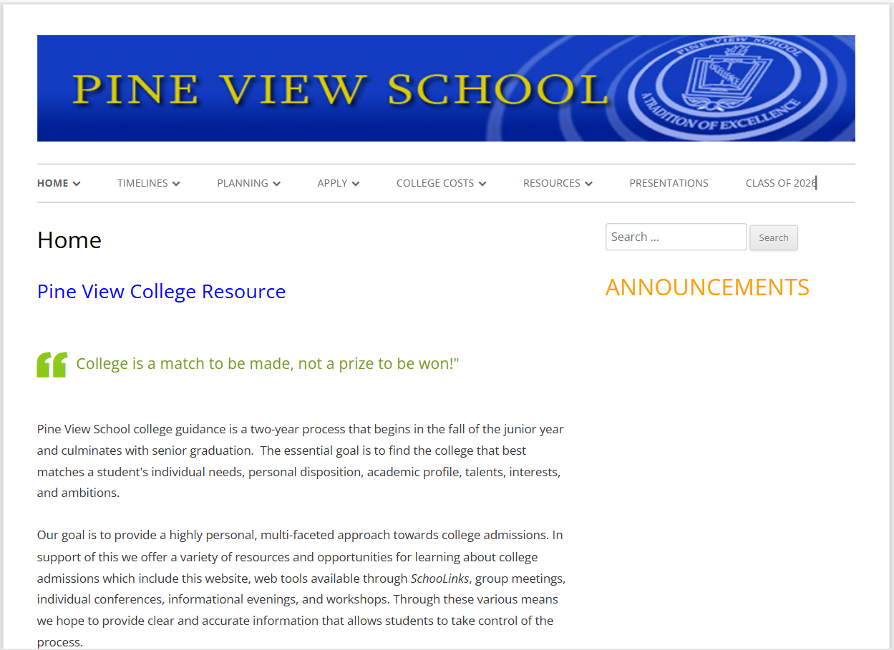
Class of 2026 College Planning - PVSCC Website
www.pvscollegecounseling.com

Slide 9
What is SchooLinks?
SchooLinks resources include College and Career Interest Surveys and Personality Assessments and a variety of College Research tools
Please complete all assigned tasks (To Dos) AND Upload Resume and Prompts as instructed
----------------------------------------------------------------------------
Pine View Transcripts, teacher recommendations, and School Profile are uploaded and sent through SchooLinks
All requests are made through SchooLinks, the use of which is required (instructions to follow in August, after the summer refresh)
SchooLinks is a separate process from your application

Slide 10
The College Admissions Landscape and Pine View School
An Introduction to the Admissions Landscape
Recent Changes in Admissions - What's Different? What Do We Control?
Pine View Student Outcomes for In-state Public Universities - What's True and What's Not?!
Selective Admissions - Data-based Reality
Counterproductive Behaviors and Their Consequences
Positive Lessons and Advice for Behaviors Moving Forward
Where we are in this Journey and What's Next?

Slide 11
The College Admissions Landscape
What has remained true?
The quality of our students (it's actually improved…)
Highly selective admissions (are even more selective)
What has changed and why?
An exponential growth in applications over the past five years
Increased virtual outreach and access by colleges and applicants
A doubling of Common App colleges since 2015 (500-->1100+)
Use of Test-optional policies (not SUS of Florida), however…
Explosive growth in international and domestic applications
Thus, far more selective and competitive than ever

Slide 12
The College Admissions Landscape
What We Control
Our accomplishments and experiences
The type and number of colleges to which we apply
The overall quality of our applications - What and how we share
How we feel about the experience and our outcomes
What We Do Not Control - Admissions Decisions
Decisions are not primarily based upon comparative ranking of individual student merit but instead on
Policies related to Enrollment Management
The Institutional Priorities of each college

Slide 13
Overall PV Admissions Data 2025 - In Progress!
Total Applicants: 1,102
Total Acceptances: 548
Total Waitlists: 110 (LY129!)
Class of 2025 (161) Class of 2024 (157) Class of 2023 (175)
Apps 1102 (6.85 Apps/) 1229 (7.8) 1348 (7.7)
Admits 548 640 664
% Accept 49.7% 52% 49%
# of Colleges 163 216 201
# Admitted To 134 IP 170 145
# Matriculated To 36 IP 62 48
In-state % TBD 62 71

Slide 14
The GREAT NEWS! - PV Data In-State USF and UCF*
University of South Florida
2025 88 Apps 87 Admit (TBD) 1 Deny
2023 109 Apps 108 Admit (28) 1 Deny
2022 112 Apps 106 Admit (29) 6 Deny
2021 38 Apps 34 Admit (10 4 Deny
University of Central Florida
2025 55 Apps 55 Admit (4 Incomplete/Waitlist)
2023 59 Apps 54 Admit (7) 5 Deny
2022 67 Apps 64 Admit (16) 3 Deny/Unk
2021 38 Apps 34 Admit (10) 6 Deny/Unk
2024 79 Apps 77 Admit (16) 2 Deny
2024 43 Apps 42 Admit (7) 1 Deny
* 34/37 applicants were accepted at ALL other in-state public universities (FAMU/FAU/FGCU/FIU/FPI/NCF/UNF/UWF)

Slide 15
Florida State University Admissions Data 2025
Total Applicants: 82,000+ applications (+7%)
Pine View Outcomes
128 Total Applications
109 Admitted - 85% admit rate (40+)
[6 Pathway Offers]-1 Waitlist pending
61 Vires Scholarship ($4000/year)
TBD Honors College Offers (appx 30+)
Over 40 anticipated to matriculate!
Five-year FSU Data
​
2024 Admissions (107 Apps)
97 Admitted (85%) 32 Enrolled
1 Pathways Offer
2023 Admissions (119 Apps)
102 Admitted (86%) 43 enrolled
7 Pathways
2022 Admissions (122 Apps)
98 Admitted (80%) 29 Enrolled
2021 Admissions (105 Apps)
90 Admitted (86%) 33 Enrolled
2020 Admissions (111 Apps)​
95 Admitted (85%) 27 Enrolled

Slide 16
University of Florida Admissions Data 2025
Total Applicants: 90,000 (74,000 in 2024) Unofficial
2018-19 38,905 Applications - 15,077 Admitted (38.7%)*
2013-14 27,107 Applications - 12,618 Admitted (46.5%)*
Pine View Outcomes
129 Completed Applications (GatorFlood)
53 Admitted (2 Appeal/1 WL pending)
26 EA/19 Defer/4 Regular/2 Late
5 PaCE/2 Gator (13% of acceptances-note)
Honors College data not released
*Common Data Set https://ir.aa.ufl.edu/reports/cds-reports/

Slide 17
University of Florida Admissions Data
Five year UF Data
2024 Admissions (105 Apps)
54 Admitted (51%) 22 enrolled
11 PaCE/4 Gator Engineering/1IA 29% of total acceptances
2023 Admissions (134 Apps)
81 Admitted (60%) 37 enrolled
17 PaCE and 15 GatorEng (40%)
2022 Admissions (159 Apps)
93 Admitted (58%) 38 enrolled
19 PaCE/6 GE - 27%
2021 Admissions (121 Apps)
64 Admitted (53%) 28 enrolled
9 PaCE/3 GE - 19%
2020 Admissions (114 Apps)
76 Admitted (66%) 35 enrolled
21 PaCE/2 GE - 30%
2025 Admissions (161 Seniors)
129 Completed Applications (GatorFlood)
53 Admitted (3 pending)
[5 PaCE/2 Gator (13% of acceptances)]
Conclusions
Pine View admits held (Class size) - Despite 18%+
PaCE/Gator Engineering numbers declined
UF Enrollment Management practices impact PV
Claims of a holistic process untrue
Admit rate is higher than others in-State

Slide 18
Academic Profile of PV Students Admitted to UF (53)
Mean UNW GPA 3.92 Range 3.45-4.0
Mean WPVGPA 5.03 Range 4.46-5.20
Mean ACT 32.05 Range 27-36
Mean SAT 1508 Range 1270-1590
Only 6 admits with 5 or fewer AP/DE courses through 11th grade
Only 6 admits with 9 or fewer AP/DE course through 12th grade
Performance within the Pine View academic context

Slide 19
Ivy League and Most Selective Colleges
Keys to Remember
PV Student accomplishments are exceptional but not unusual in these most competitive applicant pools
A limited number of seats at selective colleges (1100-->3500)
The exponential growth in applications over the past five years-(though Brown, Dartmouth and Yale are down this past cycle)
What we control (our experiences, applications and list) versus
The primary determinants in selective college admissions
Enrollment management
The Institutional Priorities of each college

Slide 20
Pine View - Ivy League+ Data/Observations
Overall applications have nearly doubled in the past 5 years. Admit rates have been halved to below 5%
Accepted students are in many cases "hooked" (First Gen, recruited athletes, legacy, under-represented)- EM and IP
2024 PV Admits were down measurably in 2025 and 2024 (10 and 9 acceptances v. 19 in 2023 (and 23 in 2022- though larger class sizes)
Numbers of PV applications have increased individually and collectively #s unjustifiably high. Between 18-25/class (less competitive apps). Decline in focus and quality of individual applications and choice to overapply

Slide 21
Highly Selective Data Observations and Conclusions
Overall applications to Highly Selective Colleges/Universities have increased exponentially over the past five years as well
PV applicants to these remain nearly as high as Ivies. Acceptances are not considerably better
UChicago2, Duke2, Vanderbilt1, Tufts1, Northwestern1 (4/7 ED)
Only 21 of the 56 students accepted the past five years to these six universities matriculated (more than half opting to attend in-state!)
Future harm and Waitlist offers! This year 110 (LY 129). 2023=77WL
Increased importance of Early Decision applications at these!!

Slide 22
Very Selective Data Observations and Conclusions
BU3/Northeastern2/Emory8/UMiami8/Georgia Tech4/UVA1 (4)
153 Accepted and only 37 Matriculated over the previous 5 years
Most used as 'back ups' though data do not support these as 'safe' or likely choices
Families apply with the hope of chasing merit dollars. Again, in most cases, these opportunities do not materialize (enough)
Students typically don't matriculate and instead attend a Florida public university (especially true of public OOS)
Harm to future yields - Yield protection
Increased importance of Early Decision applications

Slide 23
A Partial List of College Acceptances "Left on the Table" for FL Public Universities 2021-25 (This year, so far)
American Johns Hopkins University of Miami Brandeis Macalester University of Michigan Boston College Middlebury UNC Chapel Hill
Boston University Northwestern University of Virginia
Colorado College Oberlin University of Wash
Cornell Purdue Univ of Wisconsin
Davidson Tulane Wake Forest
Emory University of California Washington & Lee
Georgetown University of Colorado William & Mary
Georgia Inst Tech University of Georgia Williams College

Slide 24
Some positive application/matriculation news 2025!
Interesting and Selective Applications, Admits AND Yield!
Carleton 1 ED Macalester 1
Colby 1 ED Middlebury 1 QB
Colgate 1 ED Mt. Holyoke 1 ED
Colorado College 1 Oberlin 2
Grinnell 1 WashingtonUStL 1/1QB)
Haverford 2 (1 ED) William & Mary 1/1

Slide 25
General Observations
Each year 60-70%.+/- of Pine View students remain in-state. Why?
In-State tuition, Bright Futures and Florida Prepaid opportunities
Full use of AP and DE Credits (up to 45 credits)
Long-term trajectory (graduate school)
That said, approximately 80% of PV Seniors apply to one or more private universities each year. Why?
Motivation and opportunity (Means…maybe)
Accomplishments at PV, individual aspirations, expectation, valuing of undergraduate setting and selves

Slide 26
Harmful Behaviors in the Application Process
Overapplication (in excess of recommended apps-NACAC). Several this past year in excess of twenty -Next slide!
Misleading or untrue claims in application
Applying Early Decision (ED) and not matriculating
Self-sabotage within application. Self-report of being 'forced' to apply
Failure to cancel Regular Decision applications after an Early Decision offer (subsequently offered admission at other colleges)
Applying and being accepted to need-based only colleges, then choosing to attend in-state (previous slides)
Double deposits (committing to multiple institutions)
Ethics in the College Planning and Application Process - On PVCC website (please read)

Slide 27
Consequences of Overapplication
Individual
Diffused effort and lack of focus
Unnecessary workload and anxiety
Poorer outcomes & sadness
Institutional
Pine View reputation as a low yield institution
Fewer Regular Decision offers of admission to PV students over time
Use of Waitlist to protect yield and gauge interest

Slide 28
What does this all Mean? What to do?
Select Colleges based on how they match your interests and priorities
Properly value colleges and your family's willingness to pay (both public and private). Be willing to consider other colleges
Be sure to make a compelling case for how and why you are a match
Assess the role of demonstrated interest and the appropriateness of an Early Decision application
Assess your short and long-term goals (graduate or medical school?)
Approach the process realistically understanding the selective admissions environment (enrollment management)
Try not to take any decision personally or allow a decision to affect how you feel about yourself, nor judge the outcomes of others

Slide 29
Summer Planning - A "To Do" List
1. Create a reasonable, diversified, balanced college list (Five Ps)
2. Develop a college spreadsheet with deadlines and require-ments; testing, essay, recommendation, honors, housing…
3. Create/update your resume. Complete assigned tasks prior to meeting with Mr. Bergman (Questionnaire/Prompts)
4. Plan for any additional SAT/ACT testing
5. Create a Common App account and review the application
6. Review the Common App essay prompts and work on drafts
7. Find and review, as possible, supplemental essays

Slide 30
Student Resume, Questionnaire, and Prompts
A strong resume is an important way to showcase your academic achievements, extracurricular activities, leadership roles, and work or volunteer experience
Many Universities/Colleges will accept a resume in addition to the Activities portion of the Common Application
Please upload your resume, Questionnaire, Prompts to SchooLinks

Slide 31
Common Application 2025-26
What is the Common Application (CommonApp)?
Create a Common Application account for the purposes of reviewing the general format/requirements as well as for previewing the 2025-26 Essay Prompts
Do not begin the application as there will be a summer refresh in early August
https://www.commonapp.org/apply/essay-prompts

Slide 32
Appointments and Contact Information
Appointments with Mr. Bergman to discuss college plans will continue through June (resume after summer break-August through November)
Spring appointments are especially important for early applications (ED) and special circumstances (military, athletic, special programs)
The youcanbook.me appointment calendar is open and books three weeks out. New appointments appear each day
https://lancebergman.youcanbook.me
Please send along any questions between now and then to lance.bergman@sarasotacountyschools

Slide 33
Thank you for Coming!
The Question form will remain open until May 2, 2025

